Slide 1

Algorithms and Data Structures 1 CS 0445
Fall 2023
Recursive Searching
Sherif Khattab
ksm73@pitt.edu
(Slides are adapted from Dr. Ramirez’s and Dr. Farnan’s CS1501 slides.)

Slide 2
Announcements
Upcoming Deadlines:
Lab 4: Friday 10/27 @ 11:59 pm
Homework 7: Tuesday 10/24 @ 11:59 pm
Programming Assignment 3: Friday 11/3 @ 11:59 pm
Midterm grades are out
Please check your exam paper on GradeScope
Question reattempts open until 11/7 @ 11:59 pm
Regrade Request feature on GradeScope
Can get up to 7 points back
Correction of T/F questions must have a non-trivial explanation
Lost points in a lab assignment because of the autograder or a simple mistake?
please reach out to Grader TA over Piazza

Slide 3
Doubly-Recursive Search in an Unsorted Array
Define the problem at hand
Input(s): an array and a target item
Output: true if target found and false otherwise
Find a Base Case:
An empty array → return false
An array with a single element → check that element against target
Define a Recursive Case:
Ask “friend” to search the 1st half of the array
If friend finds target → return true
Otherwise, ask friend for help on 2nd half and return what they return
Revisit the inputs to the problem given what your friend needs to define subproblem
Add first and last indices to define the subarray given to “friend”

Slide 4
Recursive Sequential Search in an Unsorted Array
Define the problem at hand
Input(s): an array and a target item
Output: true if target found and false otherwise
Find a Base Case:
An empty array → return false
Define a Recursive Case:
Compare first element against target
If equal return true
Ask “friend” to search the rest of the array
return what they return
Revisit the inputs to the problem given what your friend needs to define subproblem
Add first and last indices to define the subarray given to “friend”

Slide 5
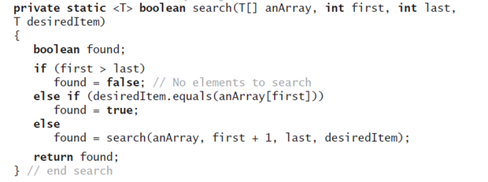
Recursive Sequential Search of an Unsorted Array
Method that implements this algorithm will need parameters first and last.

Slide 6
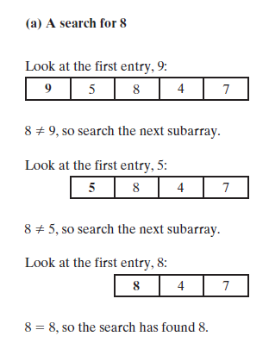
Recursive Sequential Search of an Unsorted Array
A recursive sequential search of an array that finds its target

Slide 7
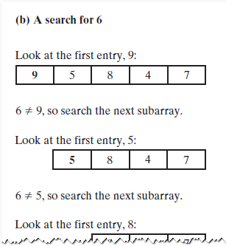
Recursive Sequential Search of an Unsorted Array
A recursive sequential search of an array that does not find its target

Slide 8
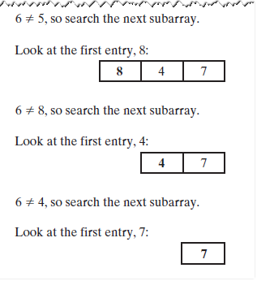
Recursive Sequential Search of an Unsorted Array
A recursive sequential search of an array that does not find its target

Slide 9
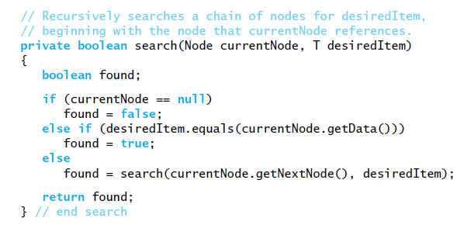
Recursive Sequential Search of an Unsorted Chain
Implementation of the method search

Slide 10
Recursive Search in a Sorted Array
Define the problem at hand
Input(s): an array and a target item
Output: true if target found and false otherwise
Find a Base Case:
An empty array → return false
Define a Recursive Case:
Compare middle element against target
If equal return true
If target < middle element
ask “friend” to search the 1st half of the array (excluding middle)
return what they return
Otherwise, ask “friend” to search the 2nd half of the array (excluding middle)
return what they return
Revisit the inputs to the problem given what your friend needs to define subproblem
Add first and last indices to define the subarray given to “friend”

Slide 11
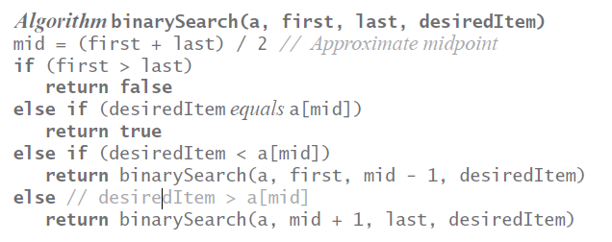
Binary Search of a Sorted Array
Recursive algorithm

Slide 12
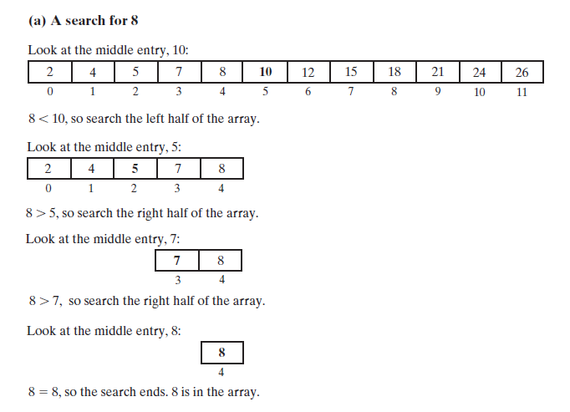
Binary Search of a Sorted Array
A recursive binary search of a sorted array that finds its target

Slide 13
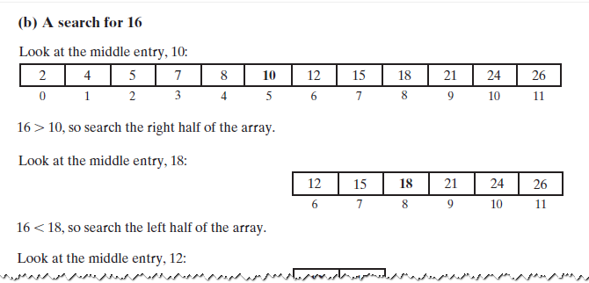
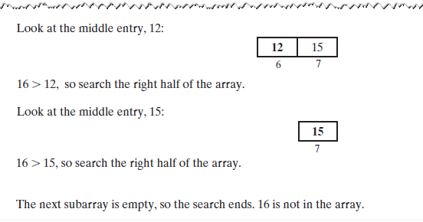
A Binary Search that doesn’t find its target
A recursive binary search of a sorted array that does not find its target

